Slide 1
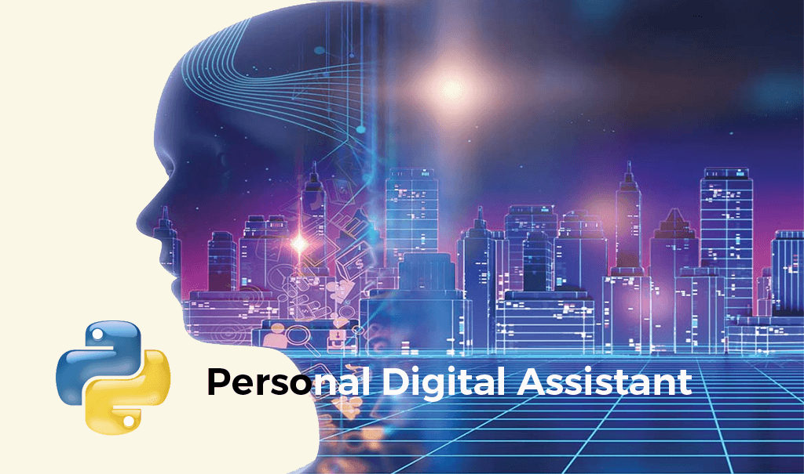

By:~ Pawan Gambhir
2210992035
G-12

Slide 2
PROJECT PROPOSAL ON VOICE ASSISTANT (ALIEN)
Presented by
PAWAN GAMBHIR
Under the supervision
of
Dr. Amandeep Kaur(Professor)
Chitkara University Institute of Engineering and
Technology (CUIET)
Chitkara University, Punjab

Slide 3
INTRODUCTION
ALIEN assistant is a project made on python as my term 1 python project, this program is basically a minor
project which can be developed alot more in near future.ALIEN Voice Assistant, it’s a project made on
python which enables user to get their work done by giving voice commands. It is a modal assistant for
now on with some features which are useful in daily uses, such as asking time, knowing weather,
searching on wikipedia and google, playing music, locking and shutting down system, sending mails etc.
The personal assistant allows you to work efficiently by giving short voice commands such as
“whats’s the time?” it’s a very basic example ,this assistant can do so much more. The reason behind
the name ALIEN is because my nickname is alien. User can even change the name of the assistant if
they want to and from then the assistant will pronounce itself with that name only. Currently ALIEN is a
beta version (1.O). GUI can be made for the assistant to make it look more clean and user friendly
. It consists of lots of libraries which were present before and some are installed later on by using pip instal.

Slide 4

MOTIVATIONS

Slide 5
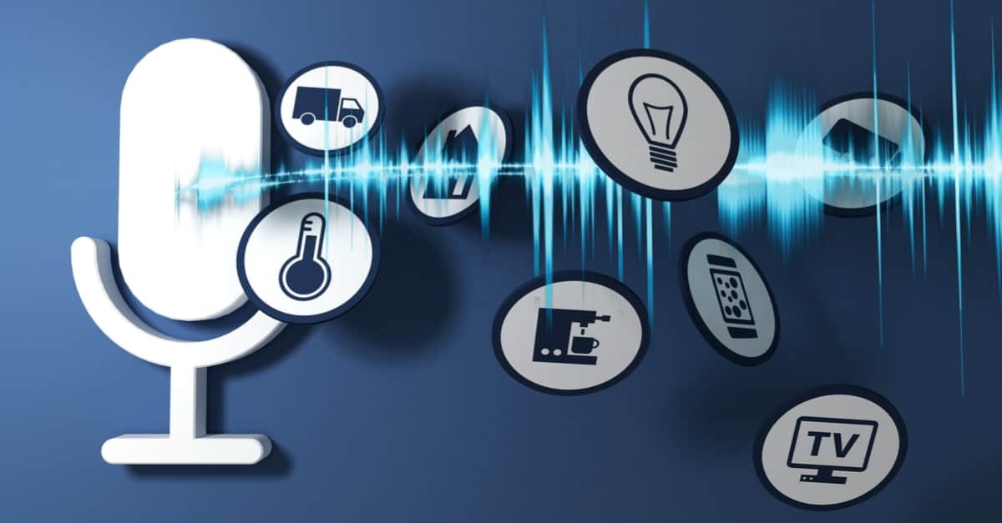
JUSTIFICATION
A voice assistant is a digital assistant that uses voice recognition, language processing algorithms, and voice synthesis to listen to specific voice commands and return relevant information or perform specific functions as requested by the user. Based on specific commands, sometimes called intents, spoken by the user, voice assistants can return relevant information by listening for specific keywords and filtering out the ambient noise.Today, voice assistants are integrated into many of the devices we use on a daily basis, such as cell phones, computers, and smart speakers.

Slide 6

PROBLEM STATEMENT
While there are many benefits, there are also drawbacks to these voice search features. People often experience frustrations when conducting a search by voice and often accidentally summon their personal assistants thanks to unintentional voice commands.

Slide 7
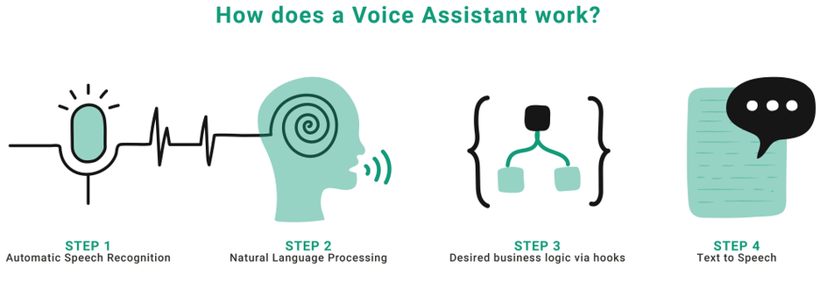
OBJECTIVE
It’s that carries out everyday tasks via voice command. It’s brings AI and machine learning together to recognize our voice and do what we ask it.
This software program use device's microphone to receive voice requests and processing on it, and send response via Speaker.
It is combination of different technologies like Voice Recognition, Language Processing, Voice Analysis.
This software program is developed using python language and his modules.

Slide 8
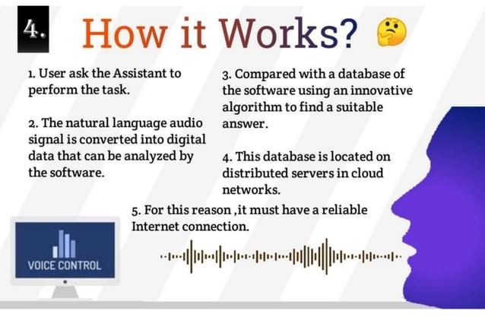

Slide 9
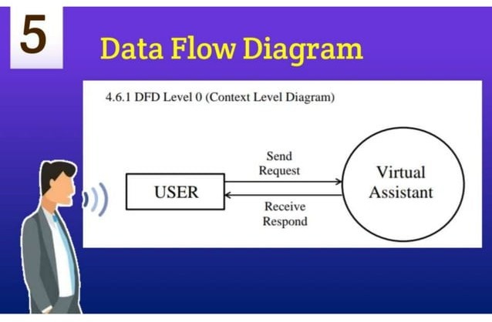
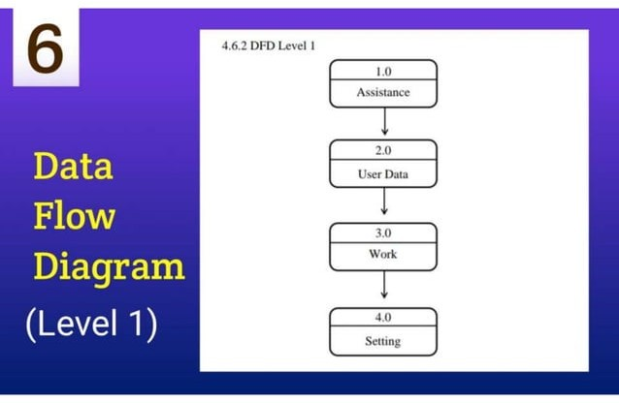
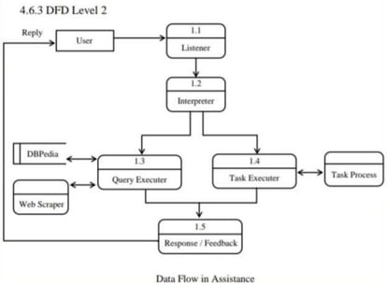
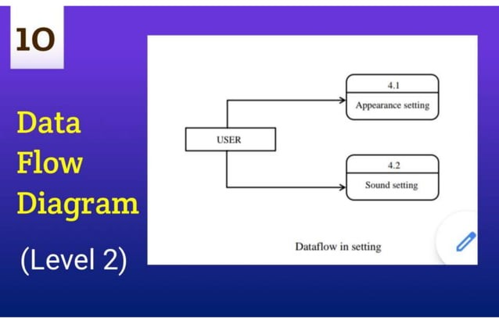
WORK PLAN

Slide 10
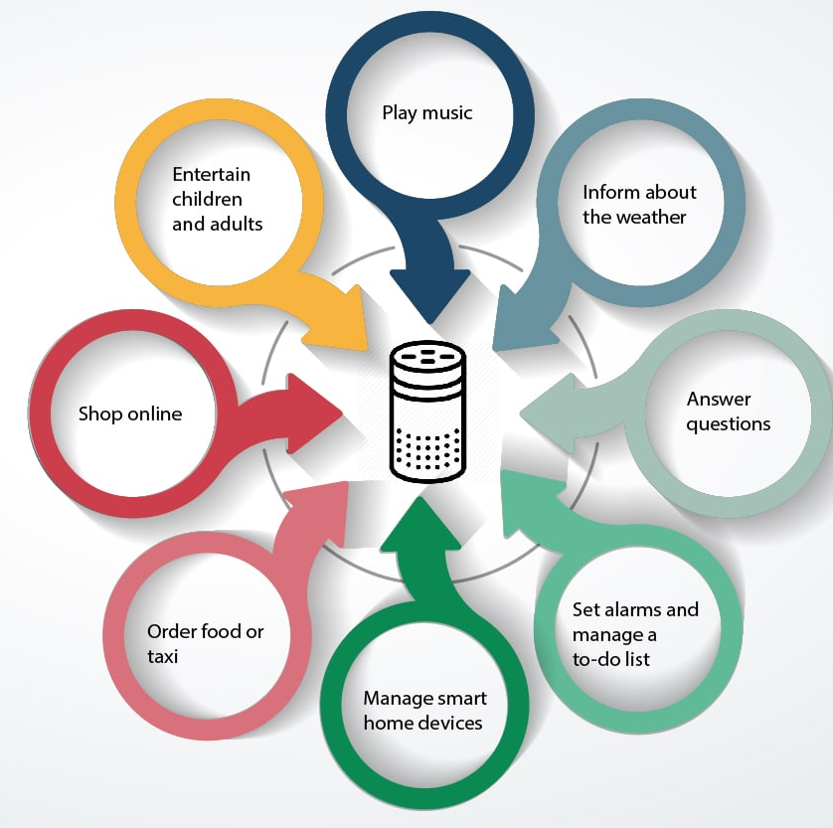
EXPECTED OUTCOMES:

Slide 11
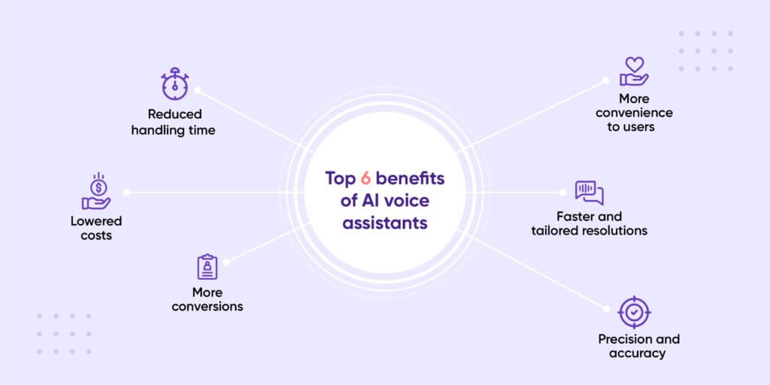

Slide 12
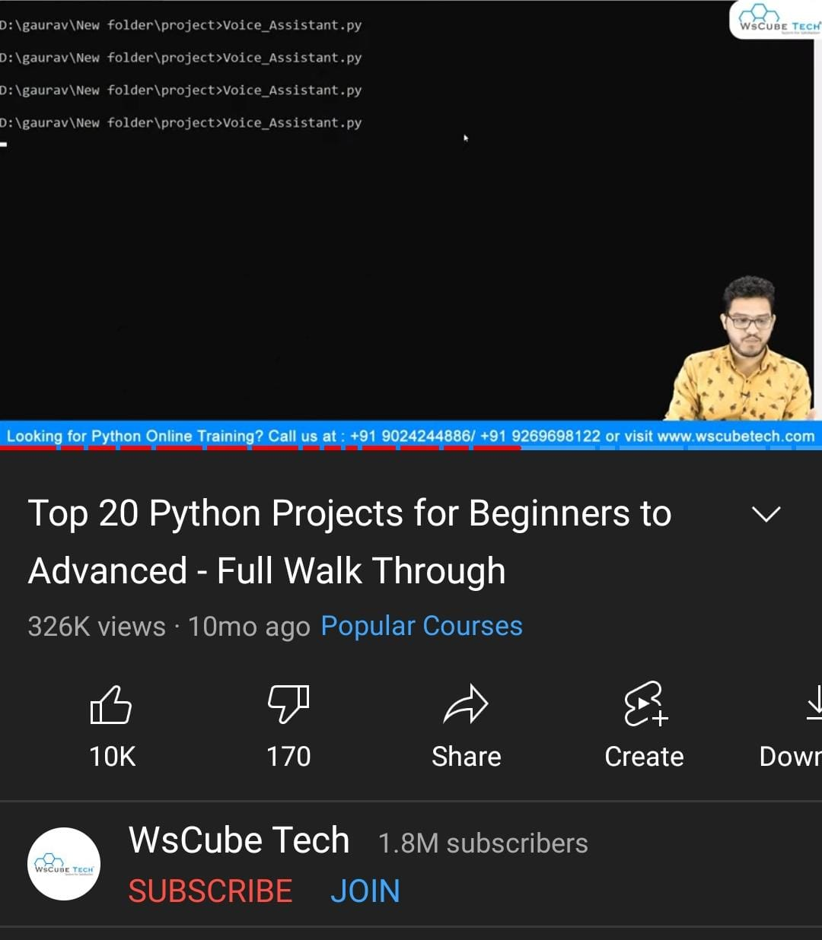
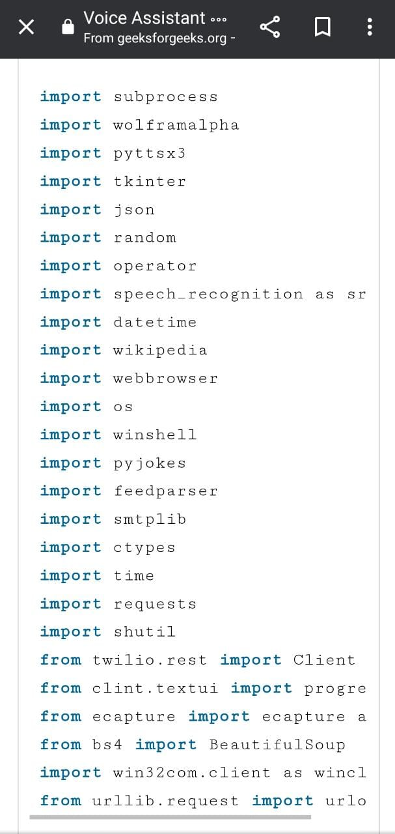
REFRENCES:
YOUTUBE
WEBSITE

Slide 13
THANK YOU!

